Slide 1
History Taking And Recording
Of Ophthalmic Cases
Chairperson : Prof. Gautam Bhaduri
Speaker : Kumar Saurabh
Notes:
nnnn

Slide 2
Technique
How to ask?
Open enquiries
Closed enquiries
Clarification
Reflection
Summary

Slide 3
Technique
What to ask?
Patient particulars
Chief compliant(s)
History of present illness
History of past ocular illness
History of ocular surgery/treatment
History of systemic diseases including STDs
Family history
Personal history
History of drug intake/addiction
Notes:
What to ask

Slide 4
Patient particulars
Name
Address
Identity records for future reference
Denotes ethnicity
Denotes the personality
Medico legal records and follow up
Endemic toxicities viz. Arsenic
Epidemiological data collection

Slide 5

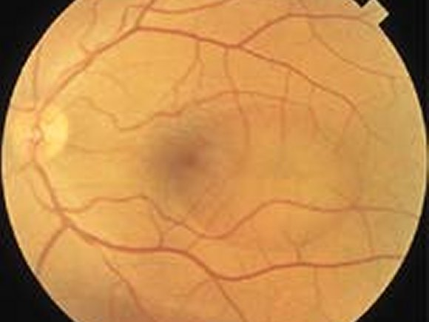
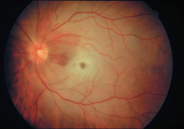
Patient particulars
Age
Children
Retinoblastoma
Rhabdomyosarcoma
Coat’s disease
Optic nerve glioma
Young adults
Parsplanitis
Central serous retinopathy
Eale’s disease
Fuch’s uveitis
Middle and older
CRAO
BRVO
ION
ARMD

Slide 6
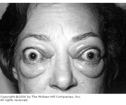
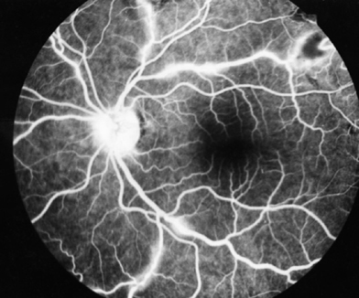
Patient particulars
Gender
Female
Dysthyroid ophthalmopathy
Chronic dacryocystitis
Angle closure glaucoma
Post-JRA uveitis
Male
Eale’s disease
Central serous retinopathy
Coat’s disease
Lacrimal tumours

Slide 7
Patient particulars
Religion and race
Occupation
Congenital anomalies in Muslims and Parsi
Trachoma in north Indians
Vitamin A deficiency in under privileged
Fungal infection in farmers
Dry eye in computer operators
Cataracts in hot furnace workers

Slide 8

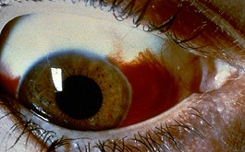

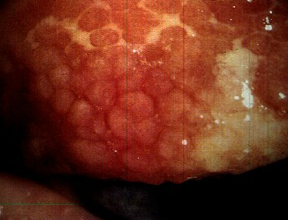
Presenting complaint

Slide 9
Visual complaint
Dimness of vision
Unilateral or bilateral
Duration
Mode of onset
Diurnal variation
Pain or without pain
Distortion of images
History of coloured halos
History of use of glasses
History of trauma

Slide 10
Dimness of vision
Unilateral
BRVO
CSR
Secondary glaucoma
Unilateral trauma
Bilateral
Senile cataract
ARMD
Primary glaucoma
Retinal vasculopathy

Slide 11
Dimness of vision
Transient
Amaurosis fugax
Vertebrobasilar artery block
Migraine
Prolonged
Senile cataract
ARMD
Glaucoma
Retinal vasculopathy

Slide 12
Dimness of vision
Sudden
Optic neuritis
CRAO & CRVO
Vitreous hemorrhage
Retinal detachment
Gradual
Senile cataract
ARMD
Primary open angle glaucoma
Retinal vasculopathy

Slide 13
Dimness of vision
With pain
Optic neuritis
Angle closure glaucoma
Keratitis
Anterior uveitis
Without pain
Senile cataract
ARMD
Central serous retinopathy
Retinal vasculopathy

Slide 14
Dimness of vision
With coloured halos
Congestive phase of ACG
Mucopurlent conjunctivitis
Migraine
Digoxin, chloroquine intake
With distorted images
Central serous retinopathy
ARMD
Astigmatism
Cataract

Slide 15
Dimness of vision
Glasses: What to ask?
Duration of use
Power of glasses
Any frequent change of power
Any refractive surgery in past
Frequent change of glasses
Uncontrolled diabetes mellitus
Keratoconus
Progressive myopia
Open angle glaucoma

Slide 16
Dimness of vision
Gradual painless
Refractive errors
Cataract
Glaucoma
Chronic maculopathy
Sudden painful
Trauma
Corneal ulcer
Acute iridocyclitis
Acute congestive glaucoma
Sudden painless
CRAO
CRVO
Vitreous hemorrhage
Retinal detachment

Slide 17
Dimness of vision
Diminished colour vision
Hereditary
Immature cataract
Optic neuritis
ARMD
Diminished central vision
Optic neuritis
Retrobulbar neuritis
Macular pathology
Diminished peripheral vision
Advanced glaucoma
Retinitis pigmentosa
Retinal detachment
AION

Slide 18
Dimness of vision
Diminished night vision
Vitamin A deficiency
Retinitis pigmentosa
Uniocular double vision
Recent corneal opacity
High astigmatism
Subluxated lens
Iridodialysis
Binocular double vision
Paralytic strabismus
Dysthyroid oculopathy
Blow out fracture
Myasthenia gravis

Slide 19
Dimness of vision
Photophobia
Corneal abrasion
Interstitial keratitis
Phlyctenular keratoconjunctivitis
UV light exposure
Glare
Immature cataract
Large pupil
Recent aphakia
Albinism

Slide 20
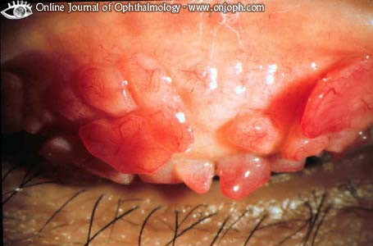
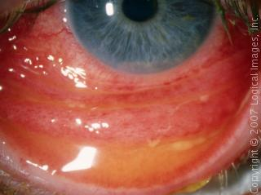
Non-visual complaint
Red eye
Without pain
Vernal conjunctivitis
Subconjunctival hemorrhage
Angular conjunctivitis
Pterygium
With pain
Infective conjunctivitis
Keratitis
Iridocyclitis
Episcleritis & Scleritis

Slide 21
Watering and discharge from eyes
Watering
Trauma or foreign body
Conjunctivitis
Blockage of drainage
Ectropion lower lid
Discharge
Watery: Viral, trachoma
Mucoid: Allergic
Purulent: Bacterial
Bloody: Trauma, membrane

Slide 22
Dryness of eyes
Infection
Trachoma
Diphtheria
Dermatological
SJ syndrome
Pemphigoid vulgaris
Exfoliative dermatitis
Others
Scleroderma
Rheumatoid arthritis
Sarcoidosis
Acid/alkali injury

Slide 23
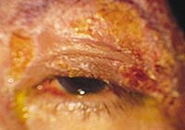
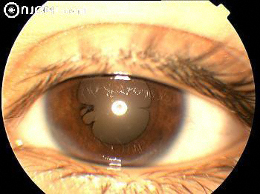
Pain
Pain in the eye ball
Trauma
Iridocyclitis
Acute angle closure glaucoma
Herpes zoster ophthalmicus
Tenderness in the eye ball
Iritis
Iridocyclitis
Retrobulbar neuritis

Slide 24
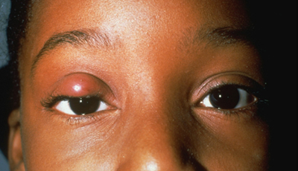
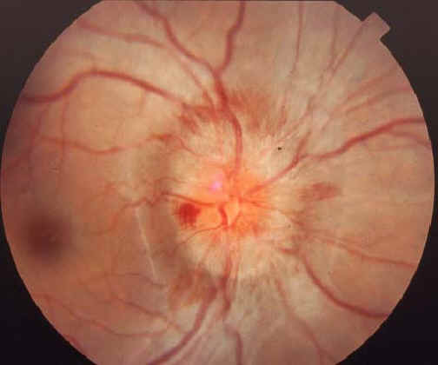
Pain
Pain around the eye
Stye
Acute dacryocystitis
Herpes zoster
Sinusitis
Pain on eye movement
Retrobulbar neuritis
Optic neuritis
Myositis
Migraine

Slide 25
Drooping of eye lids
Age of onset
Duration
Unilateral or bilateral
Diurnal variation
Family history
History of trauma
History of systemic diseases
History of surgery
Ask for old photographs

Slide 26
Bulging of eyes
Acute onset: Orbital hemorrhage
Subacute: Orbital cellulitis, panophthalmitis
Intermittent: Recurrent hemorrhage, varix
With dimness of vision: Optic nerve glioma, trauma
Without pain: Cavernous haemangioma, lacrimal tumour
With pain: Malignant, inflammatory, ruptured dermoid

Slide 27
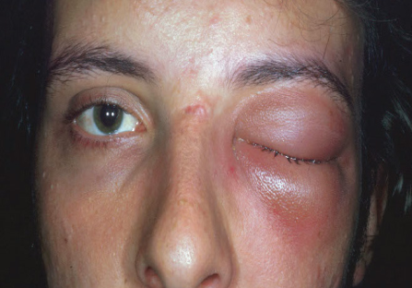
Bulging of eyes
Children
Orbital cellulitis
Retinoblastoma
Rhabdomyosarcoma
Leukemia
Adult
Thyroid ophthalmopathy
Lacrimal tumour
Cavernous haemangioma
Malignant melanoma

Slide 28
Misalignment of eyes
Age of onset
Duration
Unilateral or bilateral
Constant or intermittent
Diplopia, vertigo, past pointing
Detected by
Family history
History of surgery
Ask for old photographs

Slide 29
Floaters
Single: Weiss ring
Few: Condensation of vitreous collagen
Shower of floaters: Vitreous hemorrhage
Permanent: All of the above
Transient: Migraine

Slide 30
Headache
Hypermetropia, astigmatism
Angle closure glaucoma
Uveitis
Convergence insufficiency
Accommodative spasm
Herpes zoster ophthalmicus
Trigeminal neuralgia
Giant cell arteritis
Keratitis
Migraine

Slide 31
History of past ocular illness
Non-ischemic CRVO
Rhegmatogenous retinal detachment

Slide 32
History of systemic illness
Diabetes mellitus
Hypertension
AIDS
Sarcoidosis
Anemia, leukemia
Neurofibromatosis
Rheumatoid arthritis

Slide 33
Family history
Retinoblastoma
Congenital ptosis
Night blindness
Colour blindness

Slide 34
History of drug intake
Type of drug
Duration of use
Any change in symptom
Other side effects
Idiosyncrasy, allergy

Slide 35
History of drug intake
Cataract
Amiodarone
Busulphan
Corticosteroid, chlorpromazine
Optic neuritis
Isoniazid
Ethambutol
Streptomycin
Retinopathy
Chloroquine
Chlorpromazine
Tamoxifen
Dry eye
Anticholinergics
Propranolol
Hydrochlorthiazide

Slide 36
History of trauma cases
Time, place and circumstance of injury
History of accident or assault
Events following injury
Treatments if any, taken
Police reporting

Slide 37
Case recording
Purpose
Patient follow up
Medico-legal aspects
Academic aspects
Health insurance
Method
Patient’s details
Disease details
Classified approach
Impact on life

Slide 38
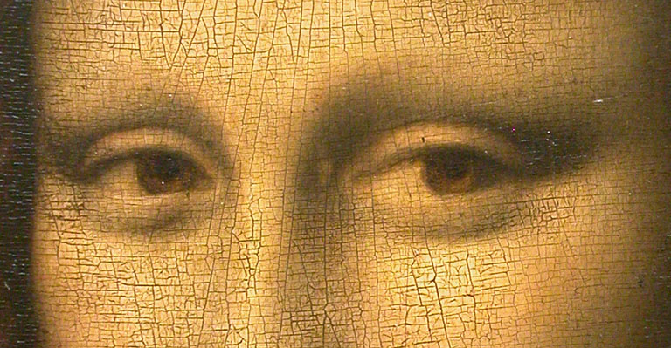
Thank You!

