Slide 2
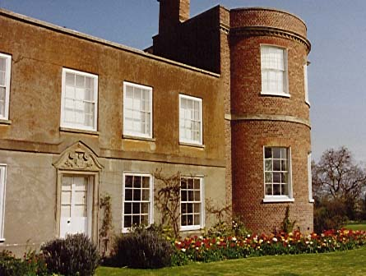
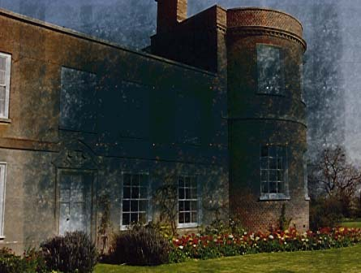
MANAGEMENT OF AGE RELATED
MACULAR DEGENERATION
CHAIRPERSON : DR. KRISHNENDU SARKAR
SPEAKER : KUMAR SAURABH

Slide 3
APPROACH TO THE PATIENT
HISTORY
CLINCAL EXAMINATION
DIAGNOSTIC TESTS
TREATMENT
FOLLOW UP

Slide 4
HISTORY
Symptoms
Age of the patient
History of smoking
History of eye ailments in family
History of use of glasses
History of drug intake
History of cardiovascular diseases

Slide 5
CLINICAL EXAMINATION
Visual acuity
Contrast sensitivity
Amsler grid test
Slit lamp indirect biomicroscopy
Fundus photography
Systemic examination

Slide 6
Visual acuity
Dimness of vision
Gradual with nonexudative AMD
Sudden with exudative AMD
Worse on pinhole testing

Slide 7
Contrast sensitivity
Reduced contrast sensitivity

Slide 8
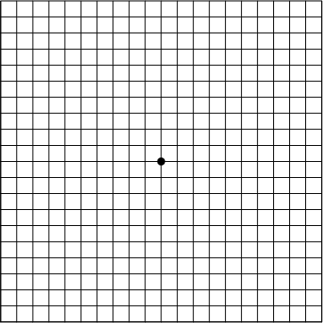
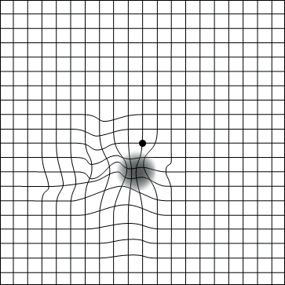
Amsler grid test

Slide 9
Slit lamp indirect biomicroscopy
Usually sufficient to establish the diagnosis
Contact lenses
60 Diopter or 90 Diopter lenses

Slide 10
Fundus photography
Used for grading of drusen
Graticules over 35mm colour fundus photograph

Slide 11
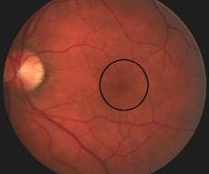
Inner macula
1500 micron
Outer macula
1500 – 3000 micron

Slide 12
DRUSEN SIZE
Compared to the width of a major vein at the edge of disc (125 micron)
Types Size
Smallest Less than one-half vein width (63 micron)
Small One-half to one vein width (63 - 124 micron)
Medium One to two vein width (125 – 249 micron)
Large Two to four vein width (250 – 499 micron)
Drusenoid PED More than four vein width ( > 500 micron)

Slide 13
NUMBER OF DRUSEN
Less than 20
More than 20
DENSITY OF DRUEN
Scattered
Sub-confluent
Confluent
TYPE OF DRUSEN
Hard
Soft
FLUORESCENCE OF
DRUSEN
Equal to choroidal fluorescence
Slightly brighter
Brightest

Slide 14
Systemic examination
Rule out diabetes mellitus
Screen for cardiovascular diseases

Slide 15
DIAGNOSTIC TESTS
Digital Fluorescein Angiography
Indocyanine Green Angiography
Optical Coherence Tomography

Slide 16
Digital Fluorescein Angiography
Less useful in non-exudative disease
DRUSEN
Hypofluorescent: Hydrophobic = High risk for PED
Hyperfluorescent: Hydrophilic = High risk for CNV

Slide 17
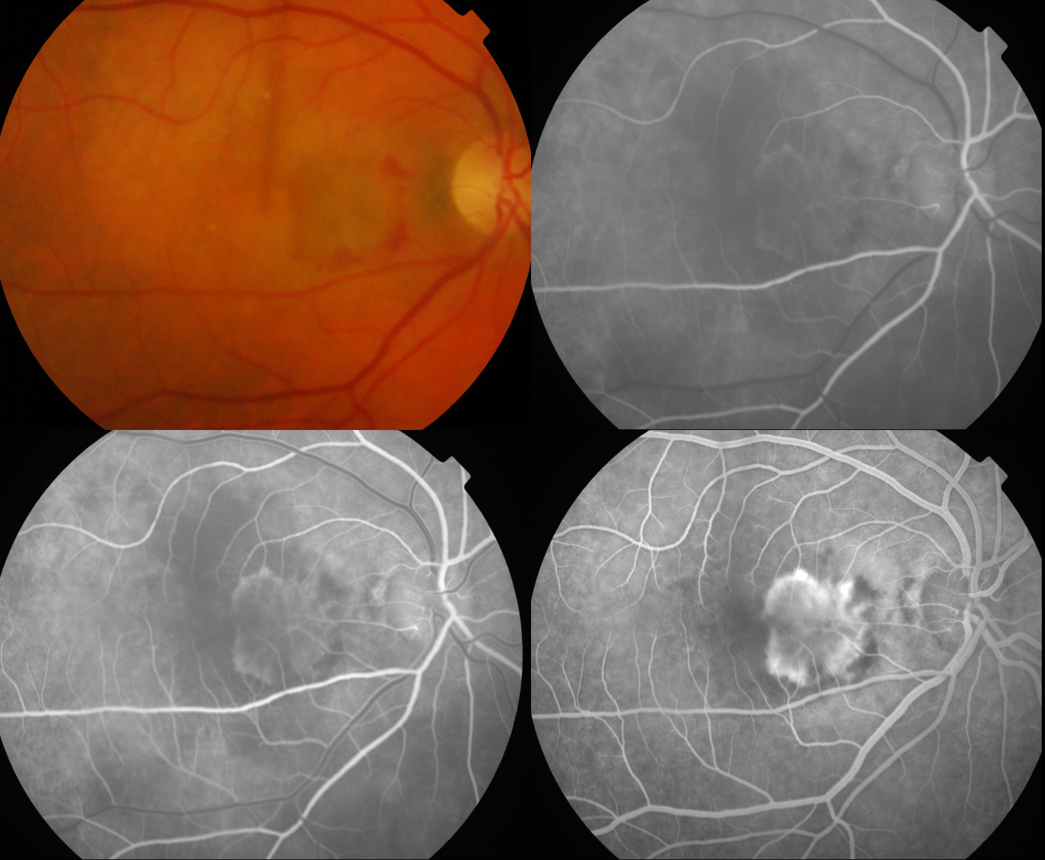
Classic CNV
Well defined area of hyperfluorescence in early phase
Bright hyperfluorescence in peak phase
Diffuse leakage and blurring of margins around 1-2 minutes.

Slide 18
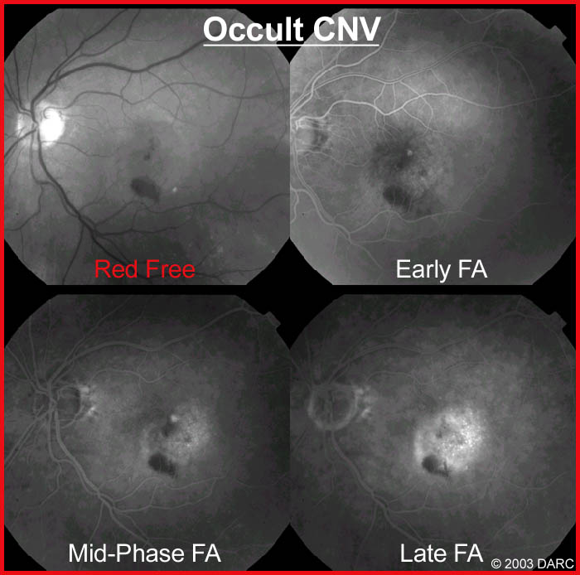
Occult CNV
Poorly defined area
Late leakage

Slide 19
Predominantly Classic CNV
Minimally Classic CNV
Occult With No Classic CNV
Classic CNV occupies
> 50% of entire lesion including contiguous blood, pigment, scar and staining.
Classic CNV occupies
1 - 49% of entire lesion including contiguous blood, pigment, scar and staining.
Classic CNV occupies 0% of entire lesion.

Slide 20
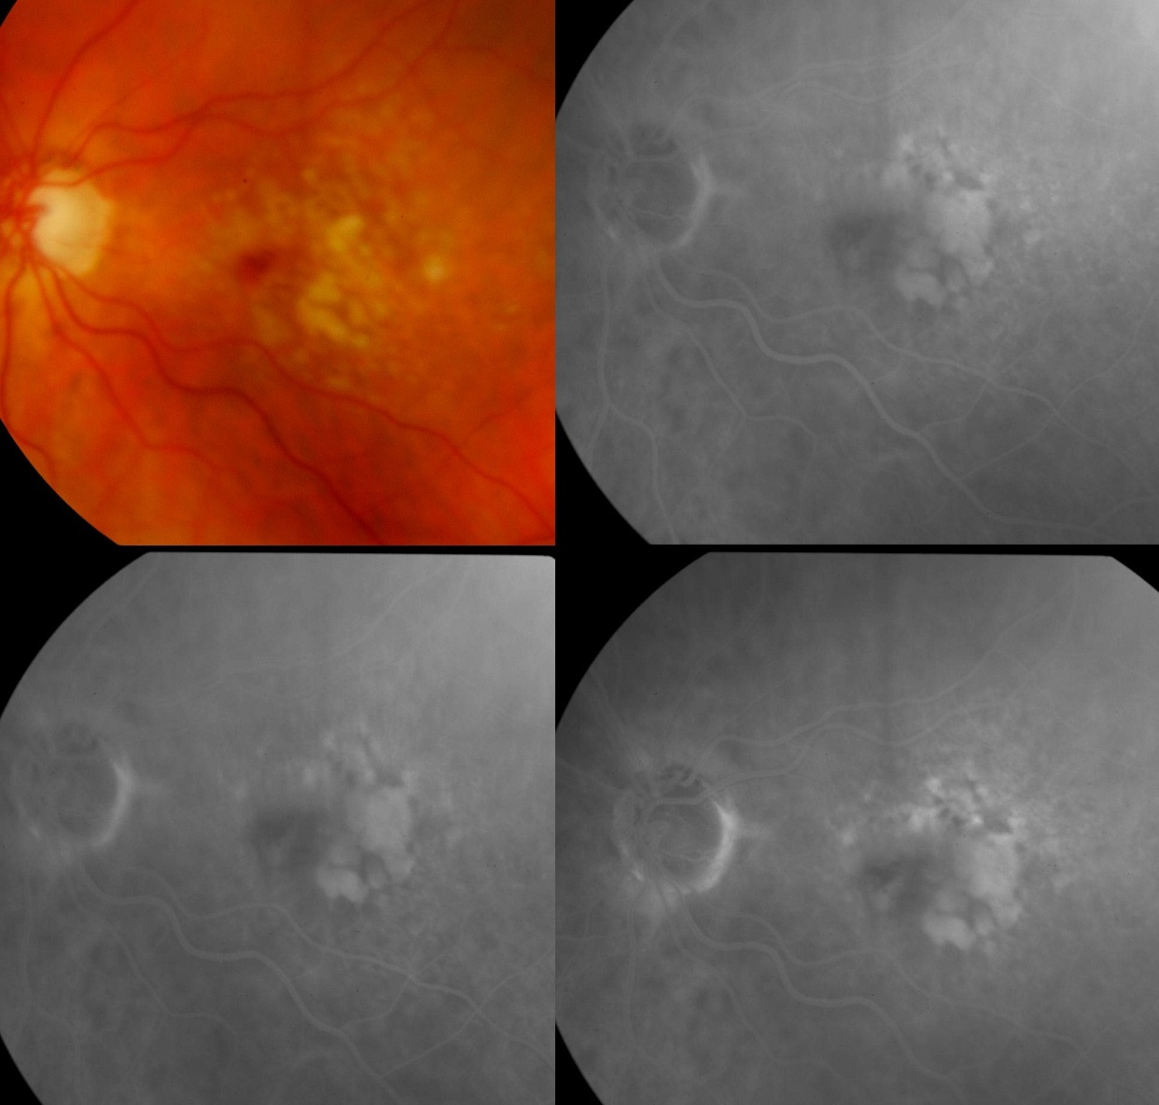
Fibrovascular PED
Stippled hyperfluorescence
Less bright and less well defined than classic CNV
Late leakage or persistent staining

Slide 21
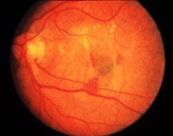
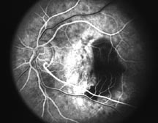
RPE Tear
Sharp well defined area of hyperfluorescence
Adjacent area of blocked fluorescence due to torn RPE
Late staining
No late leakage

Slide 22
Indocyanine Green Angiography
INDICATIONS :
Occult CNV
Distinguishing serous from fibrovascular PED
Suspected CNV with overlying hemorrhage
Recurrent CNV adjacent to photocoagulation scar

Slide 23
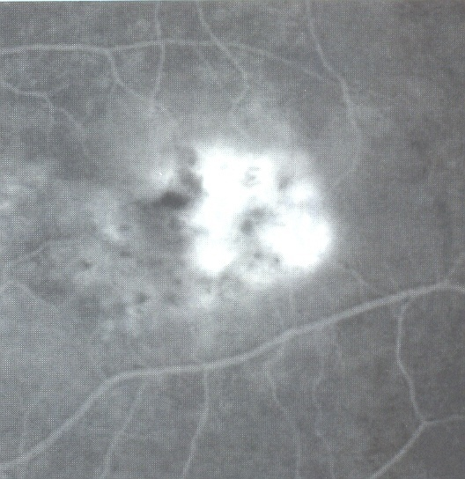
Hot spot
Occult CNV
Less than 1 disc diameter
Relatively well defined

Slide 24
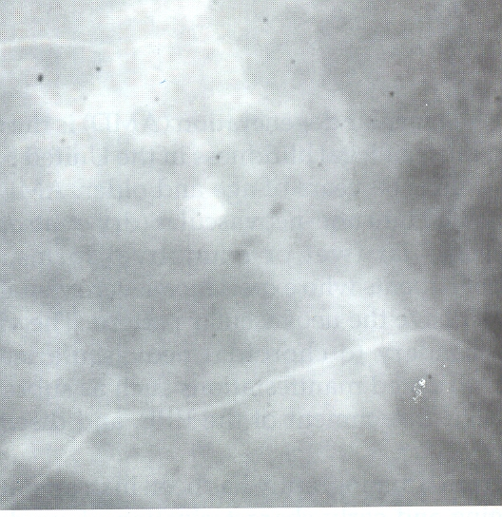
Placoid hyperfluorescence
Occult CNV
More than one disc diameter
Not well defined

Slide 25
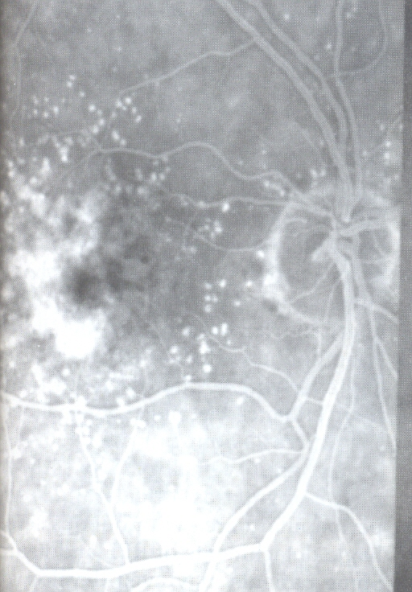
Combined lesion
Hot spot
Placoid hyperfluorescence

Slide 26
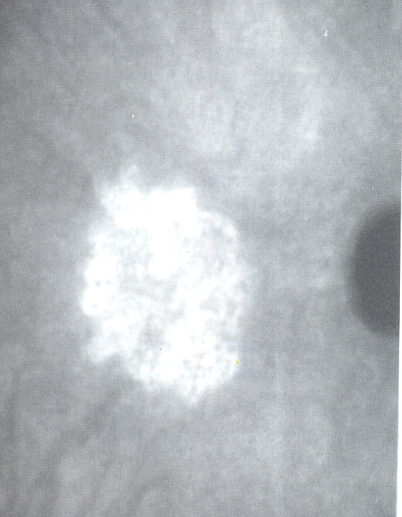
Classic CNV

Slide 27
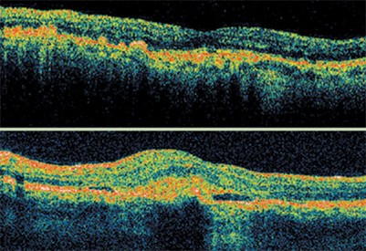
Optical Coherence Tomography
PrONTO Study: OCT detects recurrent neovascularization before vision loss
CNV

Slide 28
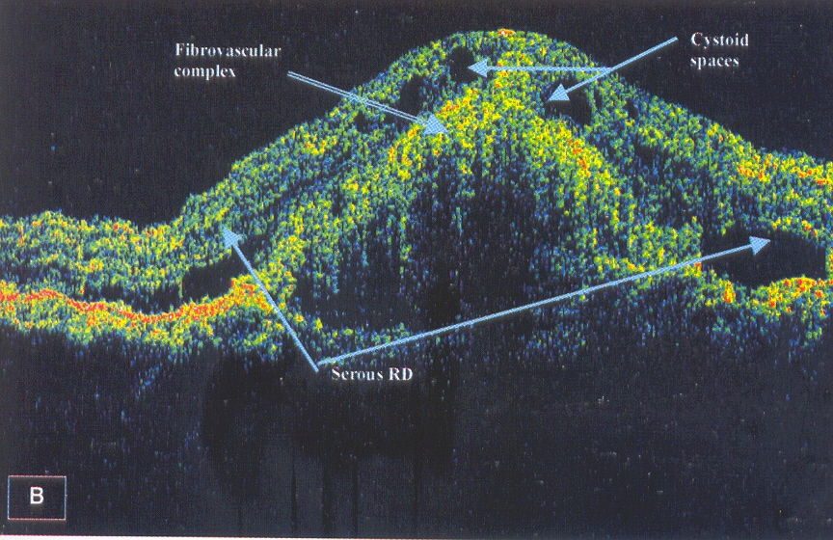
Fibrovascular PED

Slide 29
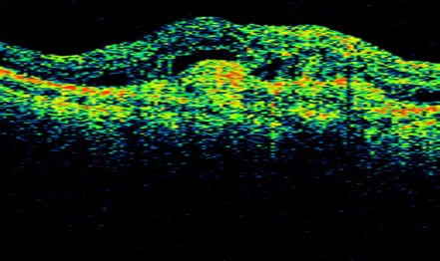
Macular scar

Slide 30
TREATMENT
Non-exudative AMD
Patient education and follow up
Low vision aids
Nutritional supplementation
AREDS Criteria
Vit C 500 mg
Vit E 400 IU
Beta Carotene 15 mg
Cupric Oxide 2 mg
Zinc Oxide 80 mg
Extensive intermediate drusen
At least one large druse
Noncentral geographic atrophy
Advanced AMD in one eye

Slide 31
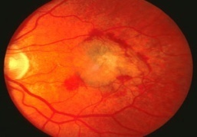
TREATMENT
Exudative AMD
Laser Photocoagulation
Extra-foveal CNV
Juxta-foveal CNV
200 micron spot size; 0.2-0.5 second duration
Krypton laser or Argon laser

Slide 32
ICG Assisted Feeder Vessel Photocoagulation
Sub-foveal CNV
Aimed at closure of extra-foveal feeder vessel
Preserves the foveal tissue

Slide 33
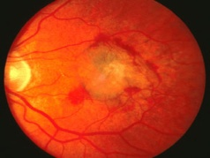
Transpupillary Thermotherapy
Proposed for sub-foveal occult CNV
810 nm diode laser
Single large spot is used
TTT4CNV has shown no statistically significant benefit over sham treatment

Slide 34
Photodynamic Therapy
Predominantly classic sub-foveal CNV
Definite Indications
Occult sub-foveal CNV with recent disease
progression (lesion size < 5400 micron)
Possible Indication
Minimally classic occult CNV approaching 50%

Slide 35
PDT Agents & Methods
Verteporfin (Visudyne)
Rostaporfin (Photrex)
Motexafin lutetium (Optrin)
Talaporfin sodium
6mg Verteporfin/metre²
Diode laser, 689nm,
Energy 50J/cm²
Intensity 600mW/cm²
Spot size 1000 micron
Time 83 seconds

Slide 36
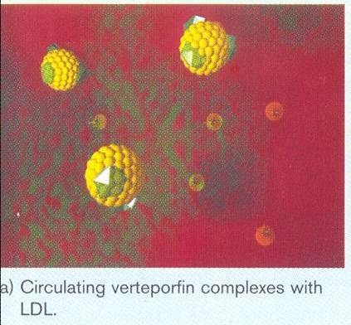
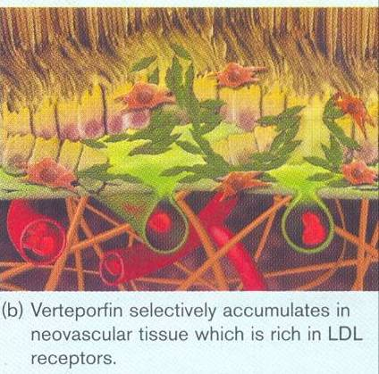
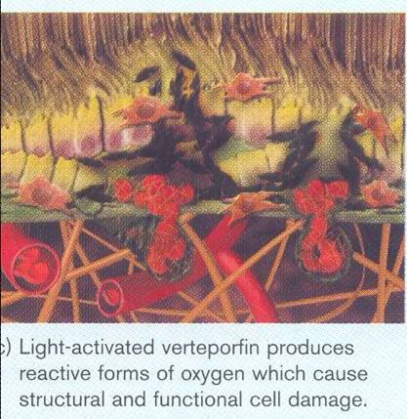
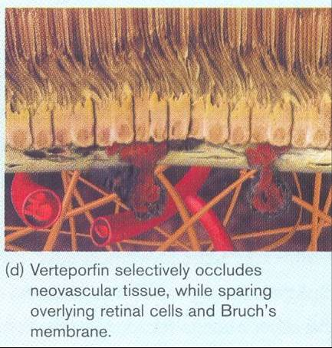

Slide 37
Receptor Targeted PDT
Verteporfin + VEGF Receptor 2 antagonist
Aimed at reducing collateral damage of adjacent retina
Combination PDT
Verteporfin + Intravitreal Triamcinolone acetonide
Aimed at reducing the increased post-PDT VEGF expression

Slide 38

Anti- VEGF Aptamer
Pegaptanib Sodium (Macugen)
28 base pegylated RNA aptamer
Binds to VEGF 165
0.3mg intravitreal every 6 weeks for 2 years
All types of CNV

Slide 39
Anti- VEGF Antibody
Ranibizumab (Lucentis)
Recombinant humanized monoclonal antibody Fab fragment
0.3-0.5mg(0.05 ml) intravitreal injections monthly for 2 years

Slide 40
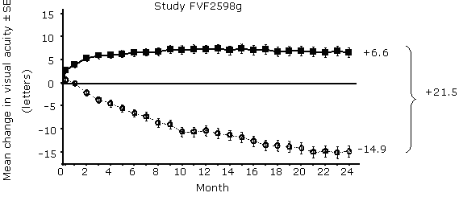
MARINA Trial
Minimally Classic/Occult Trial Of The Anti-VEGF Antibody Ranibizumab In Treatment Of Neovascular AMD
Goal
To assess the safety and efficacy of Ranibizumab in a sham injection controlled study
Outcome measure | Month | Sham (n=238) | Ranibizumab 0.5 mg (n= 240)
Loss of < 15 letters in visual acuity (%) | Month 12 | 62% | 95%
 | Month 24 | 53% | 90%

Slide 41
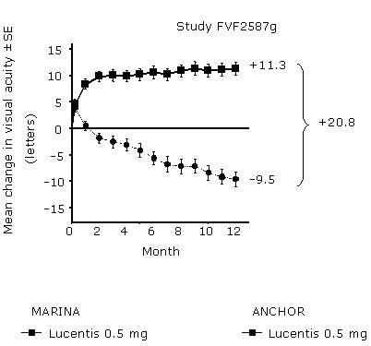
ANCHOR Trial
Anti-VEGF Antibody For The Treatment Of Predominantly Classic Choroidal Neovascularization In AMD
Goal
To compare the safety and efficacy of Ranibizumab to Verteporfin PDT
Outcome measure | Verteporfin PDT (n=143) | Ranibizumab 0.5 mg (n= 140)
Loss of < 15 letters in visual acuity (%) | 64% | 96%
Gain of more than 15 letters in visual acuity (%) | 6% | 40%

Slide 42
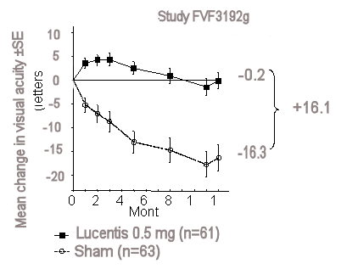
PIER Trial
Phase IIIb, Multicenter Randomized, Double Masked, Sham Injection Controlled Study Of The Safety And Efficacy Of Ranibizumab
Goal
To assess whether fewer injections of Ranibizumab can result in better visual outcomes than sham-injected controls

Slide 43
Bevacizumab (Avastin)
Complete monoclonal antibody to VEGF
1.25mg/0.05ml intraocularly

Slide 44
Steroid Compounds
Triamcinolone Acetonide
Maximum antiangiogenic effect at 3 months
Little or no effect at 1 year post-injection
Single 4mg intravitreal injection
Anecortave Acetate
Another potent steroid being studied for subtenon injection

Slide 45
Macular Surgery
Surgical Removal Of CNV
Macular Translocation
Limited Macular Translocation
RPE Transplantation
SST did not show any benefit with submacular surgery over observation alone for subfoveal CNV

Slide 46
Future Trends
Small Interfering RNA Therapy
Combretastatin A-4 Phosphate Prodrug
Squalamine
Pigment Epithelium Derived Factor Inducer

Slide 47
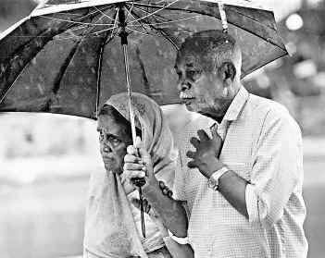
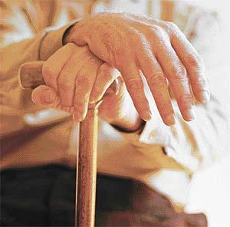
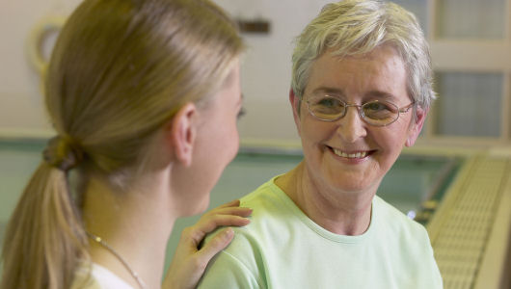
Thank You

